Slide 1
Handwritten Digit Recognition System
An UI based Offline Recogniser

Slide 2
Rishab 1505137 (CSE) Anish Hota 1505095 (CSE) Anand Kumar 1505361 (CSE) Champak Sinha 1505205 (CSE) Under the guidance of Pranesh Biswas 1505232 (CSE) Dr. Jyotismita Chaki
Presented By:

Slide 3
Contents
Introduction
Goal
Proposed Framework
Approach for Training
Approach for Testing
Pre-Processing
Classifiers
KNN Classifier
Random Forest Classifier
Support Vector Machines
Results and Comparison
Summary and Conclusion
References

Slide 4
Introduction
The significant task of handwritten digit recognition has great importance in the recognition of postcodes sort mail, bank check amounts and so on. Since three decades, there is no single classifier performs the best for all pattern classification problems consistently.
Our work is focused on an accurate and feasible method applied and tested on training set (5,000 Images) and test set (2,500 Images) of MNIST Handwritten digit database and additional custom digits.

Slide 5
Goal
Our goal for this project is quite simple we want to take data from images of hand-drawn digits and classify them as a number from 0 to 9.
We will classify the digits by training on training set we obtained from a public database (MNIST) and custom digits entered through the User Interface by the user.

Slide 6
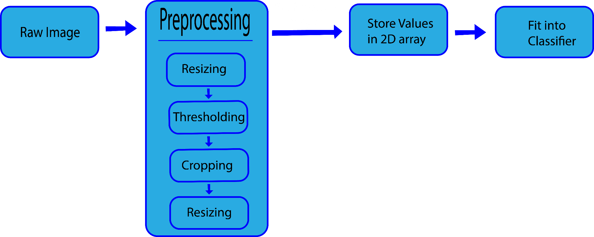
Proposed Framework: Approach for Training
The way we pre-processed the data is shown in the flow chart below and is explained later in the report.

Slide 7
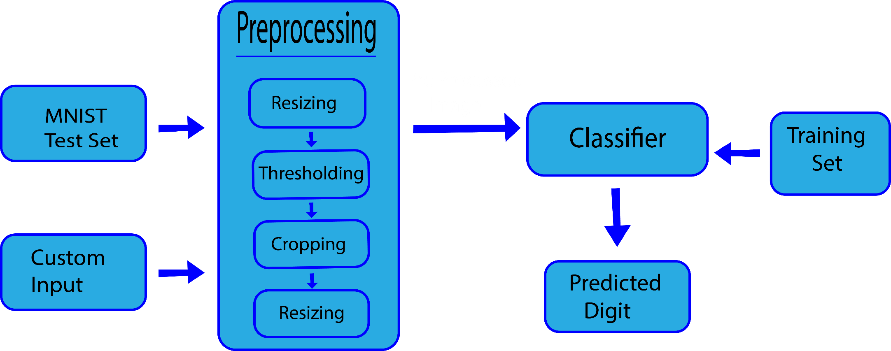
Proposed Framework: Approach for Testing
Both of the testing ways needed preprocessing and then the preprocessed images were sent to the classifier which then classified the digits from 0-9. The testing phase and the steps followed are shown in the flow chart below:

Slide 8
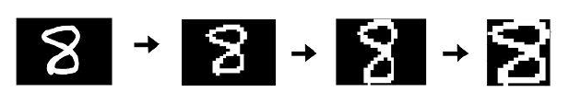
Pre-Processing
Resizing: Every image that was input was resized to 28x28 px in order to maintain a standard size.
Thresholding: To partition the image into foreground and background.
Cropping: The removal of unwanted areas from an image.
Original After Thresholding Row Cropping Column Cropping

Slide 9
Classifiers
The classifiers used for English Handwritten Digit Recognition were Linear SVM, Polynomial SVM of degree 5, KNN classifier and the Random Forest Classifier.
The classifiers were trained on MNIST dataset for handwritten digits and then tested in two phases.
The first test set was from the MNIST dataset itself. The second test was not a test set but showed real time prediction using our UI. The test cases were passed into the classifier and the accuracy was measured and noted.

Slide 10
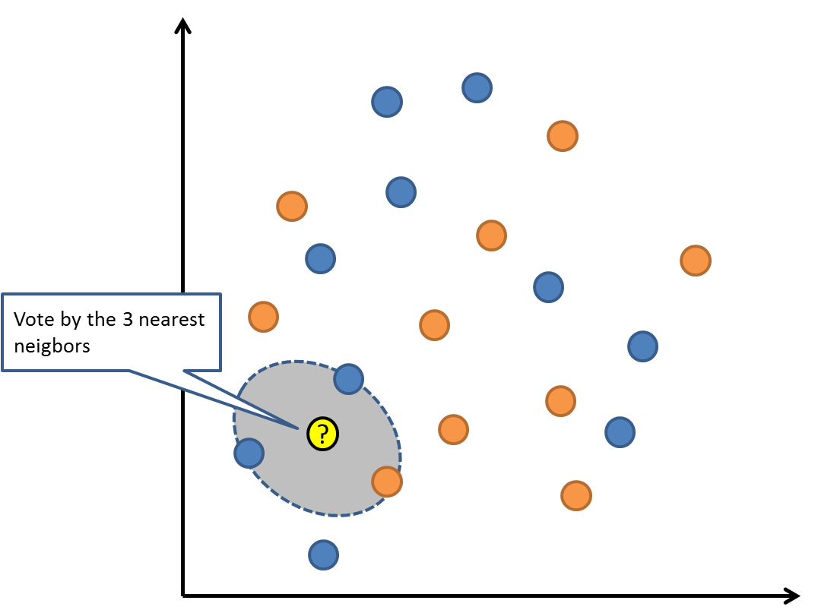
KNN Classifier
K nearest neighbours is a simple algorithm that stores all available cases and classifies new cases based on a similarity measure (e.g., distance functions). KNN has been used in statistical estimation and pattern recognition already since the beginning of 1970’s.

Slide 11
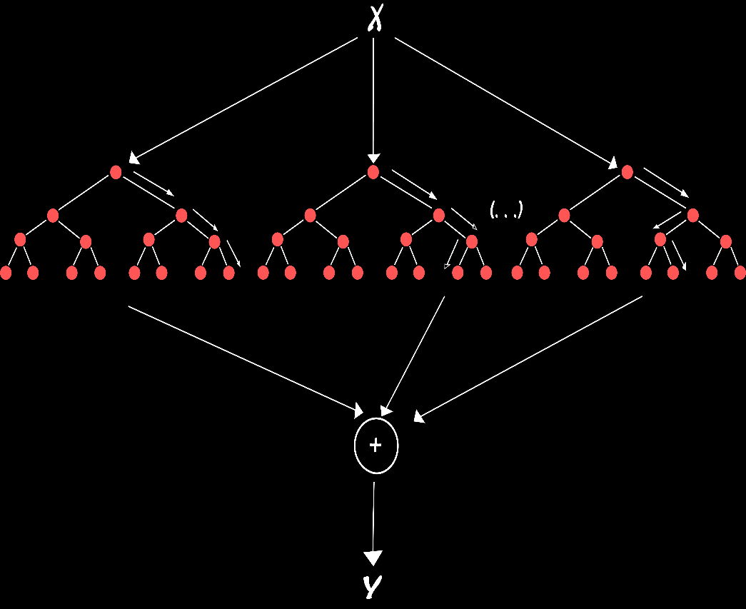
Random Forest Classifier
One big advantage of random forest is, that it can be used for both classification and regression problems, which form the majority of current machine learning systems. I will talk about random forest in classification, since classification is sometimes considered the building block of machine learning. Below you can see how a random forest would look like with two trees:

Slide 12
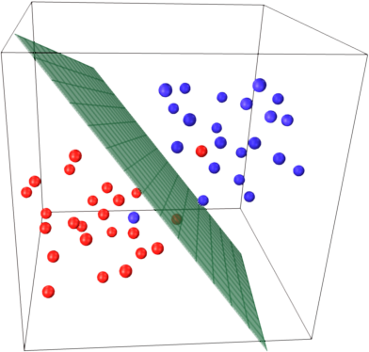
Support Vector Machines
A Support Vector Machine (SVM) performs classification by constructing an (N-1) dimensional hyperplane for an N dimensional vector that optimally separates (classifies) the data into two categories.

Slide 13
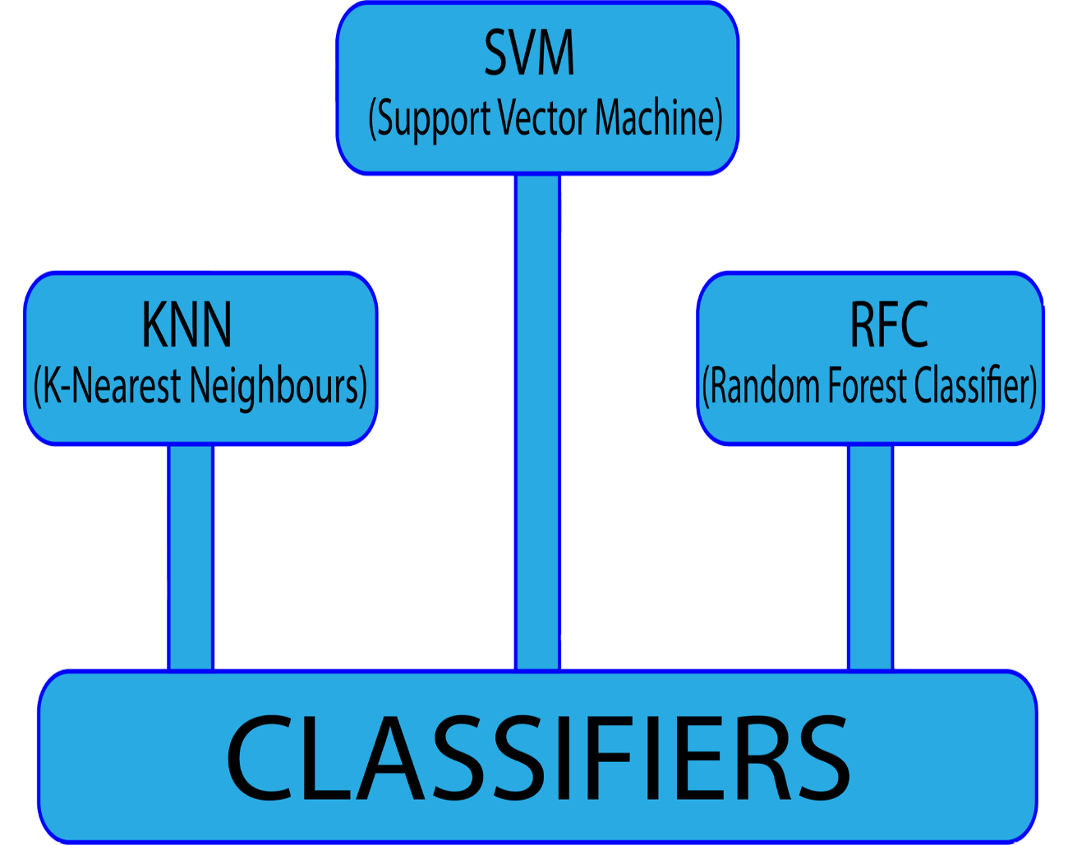
Results and Comparison
The accuracy of Polynomial SVM was found to be 94.76% which was the highest amongst the classifiers compared.
The accuracy of Linear SVM was found to be 91.3%.
The accuracy of KNN Classifier was found to be 88.73%.
The accuracy of RFC was found to be 80.6%.

Slide 14
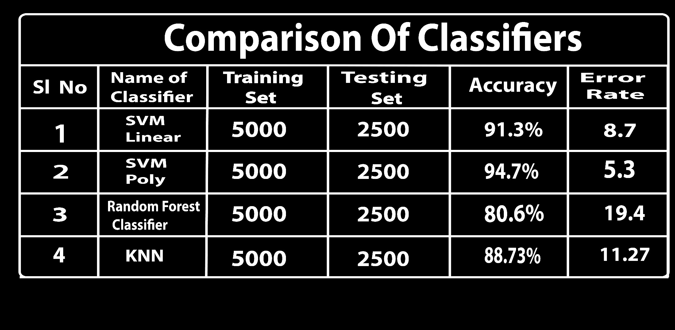
Results and Comparison

Slide 15

Working Sample

Slide 16
Summary and Conclusion
We have described a simple approach for processing and classification for English Handwritten digit recognition. Four classifiers were used for the recognition process each of which classified the digits into 10 categories based on their respective results. The overall performance was 90% for the recognition of custom digits and 94.7% for the 2,500 MNIST test digit images.
In the future work, an online implementation of the same and we will build an application that could recognize a string of digits, not just a single digit. It will be an implementation of complete Optical Character Recognition system and hope to implement it using Neural Networks.

Slide 17
References
[1] Feature Set Evaluation for Offline Handwriting Recognition Systems, http://ieeexplore.ieee.org/document/7321805/
[2] THE MNIST DATABASE OF HANDWRITTEN DIGITS, http://yann.lecun.com/exdb/mnist/
[3] K-nearest Neighbours Algorithm, https://en.wikipedia.org/wiki/K-nearest_neighbors_algorithm
[4] Random Forest, https://en.wikipedia.org/wiki/Random_forest
[5] Support Vector Machine, https://en.wikipedia.org/wiki/Support_vector_machine
[6] Digit Recognizer, https://www.kaggle.com/c/digit-recognizer

